Slide 1
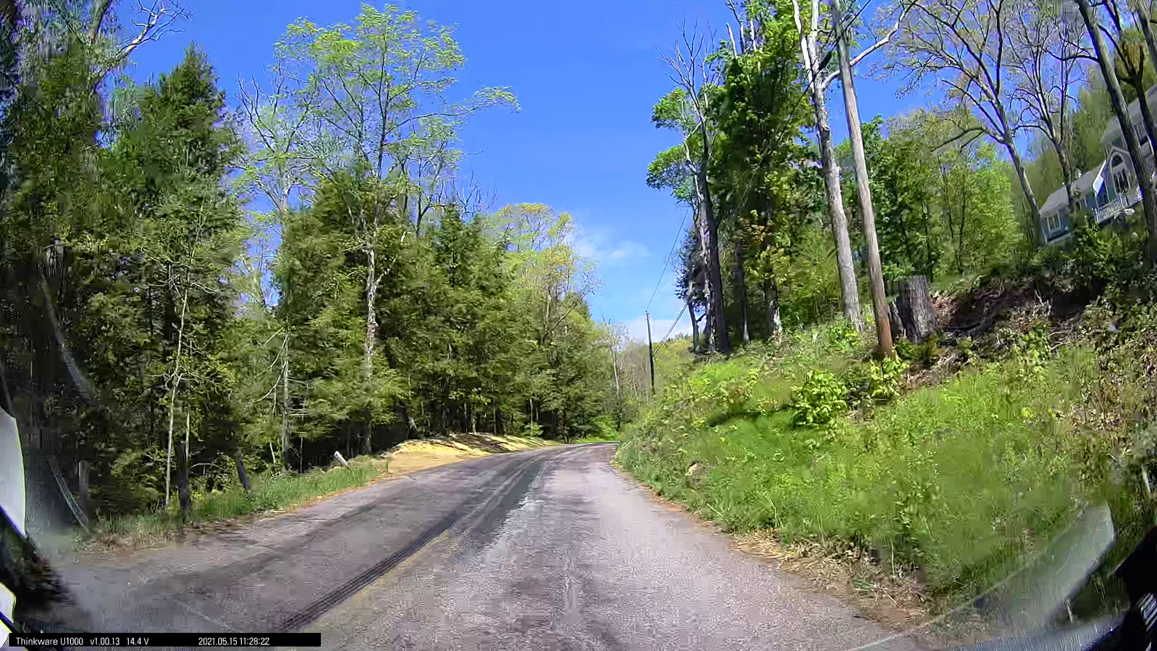
Evaluating Biomechanical and Structural Response to Tree Trimming Nicholas Cranmer, Robert Fahey, Chandi Witharana,Thomas Worthley, Amanda Bunce, Brandon Alveshere - Department of Natural Resources and the Environment

Slide 2
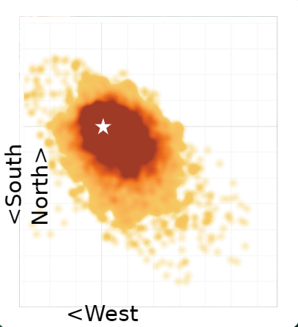
Primary objective:
Prior work has provided an understanding of tree biomechanics and effects of forest management on tree stability
Need to better understand effects of tree trimming on biomechanics and structure to fully understand the effects of utility management on tree stability
Research Questions:
How do different utility trimming specifications affect tree movement characteristics and structure?
Does tree structure after trimming affect tree stability during severe wind events?

Slide 3
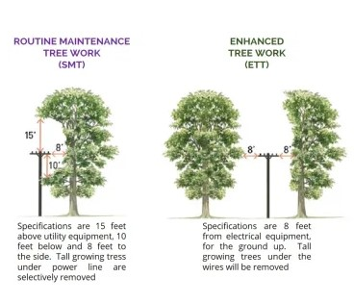
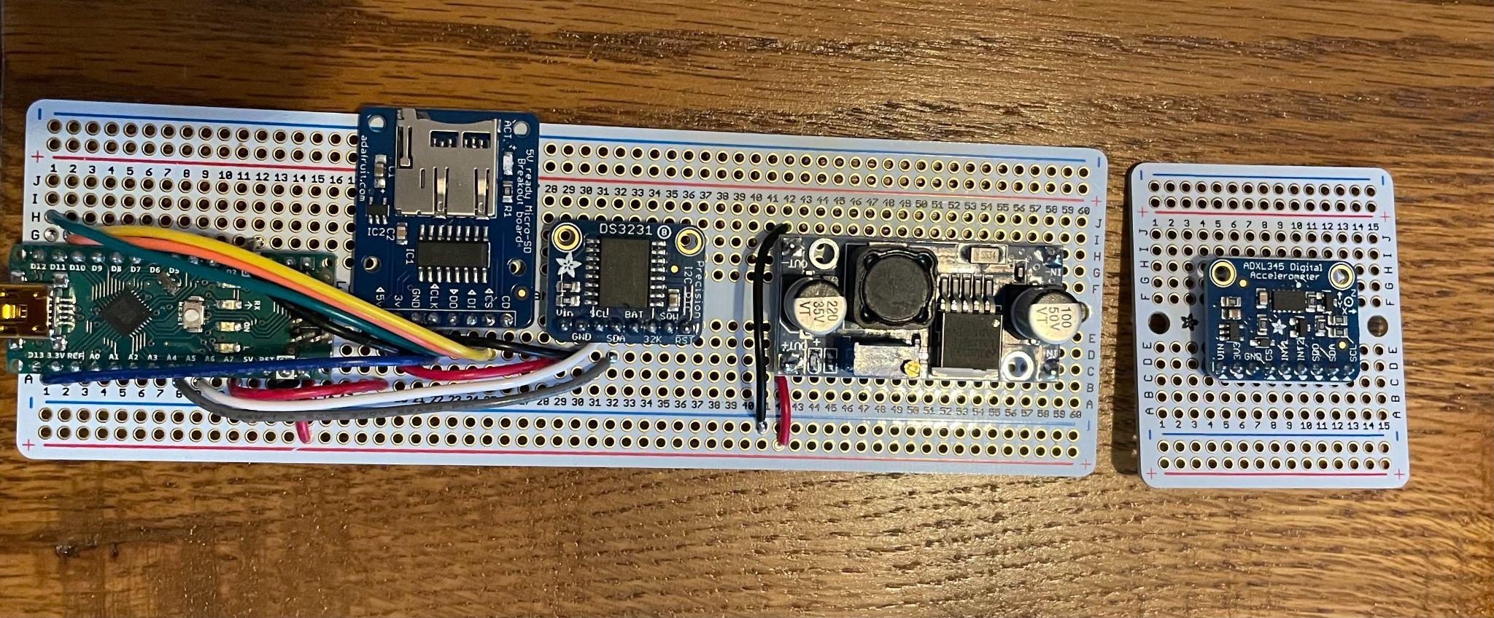
Methods:
Three roadside forest edges at UConn
Primarily focused on hardwood species along CT roadsides (Acer spp., Quercus spp., & Carya spp.) which includes a range of sizes
Trees instrumented with data logger/accelerometer to measure angles of incline in the wind (tree sway)
Trimming treatments randomly assigned to trees: Enhanced Tree Trimming and Scheduled Maintenance Trimming (SMT and ETT)
Trimming planned for Spring/Summer 2022

Slide 4
Project Deliverables:
Data describing pre and post trimming tree biomechanics and movement characteristics in field wind conditions
LiDAR derived datasets pre and post trimming from Terrestrial Laser Scanner (TLS) and Lidar equipped Drone
Dataset of leaf on/leaf off tree sway data characteristics for trimmed trees
Improved understanding of EMT & SMT effects on roadside trees to mitigate infrastructure damage/power outages

Slide 5
Project Status/Timeline:
Fall 2021:
Site setup
Pre-trimming TLS/Drone scans (leaf-off)
Tree sway data (leaf-off)
Summer 2022:
EMT + SMT trimming across sites
Post-trimming TLS/Drone scans (leaf-on)
Post-trimming tree sway data(leaf-on)
Spring 2022:
Tree sway data (leaf-on)
Pre-trimming TLS/Drone scans (leaf-on)
Fall 2022:
Post-trimming tree sway data (leaf-off)
Post-trimming TLS/Drone scans (leaf-off)
Contact information:
nicholas.cranmer@uconn.edu
Website: Stormwise.uconn.edu

